Slide 1
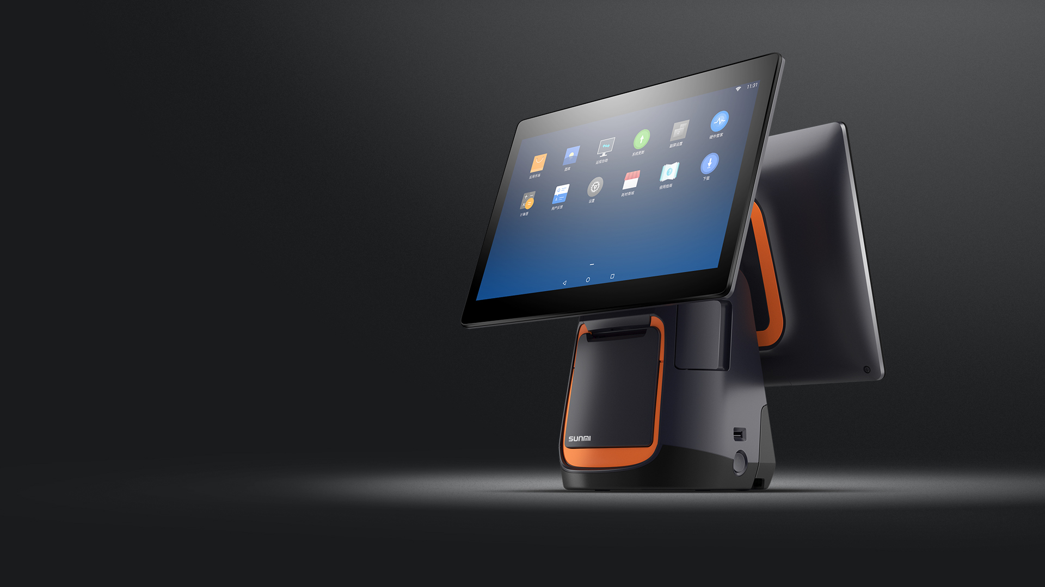
Sunmi T2
Terminal printer integrated
With the rapid development of the new retail industry, the networking of POS terminal is become more important. In order to provide a “better experience” to customers, Sunmi upgrade T1 to T2. T2 is a new generation of POS terminal, they become more advanced, more intelligent and easier to use.

Slide 2
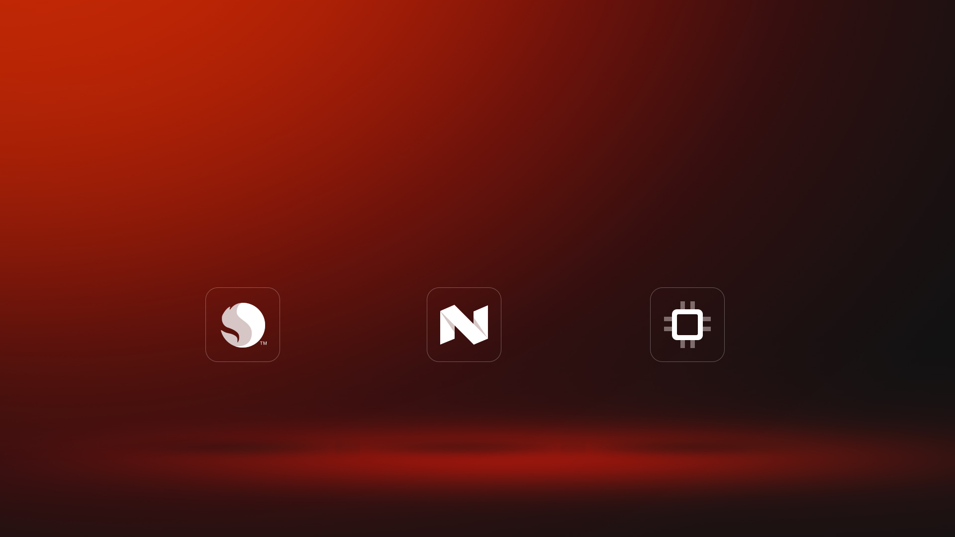
Faster and Powerful
Technology brings the Future
Both Qualcomm and Sunmi OS in T2 series will inspire you a lot.
Qualcomm Snapdragon
Android 7.1
2G RAM+16G ROM
Mobile processor leader
High performance,Low-power dissipation、Various external ports
Secure and Stability upgrade
Running speed increase 60%
Powerful RAM
16GB big memory

Slide 3
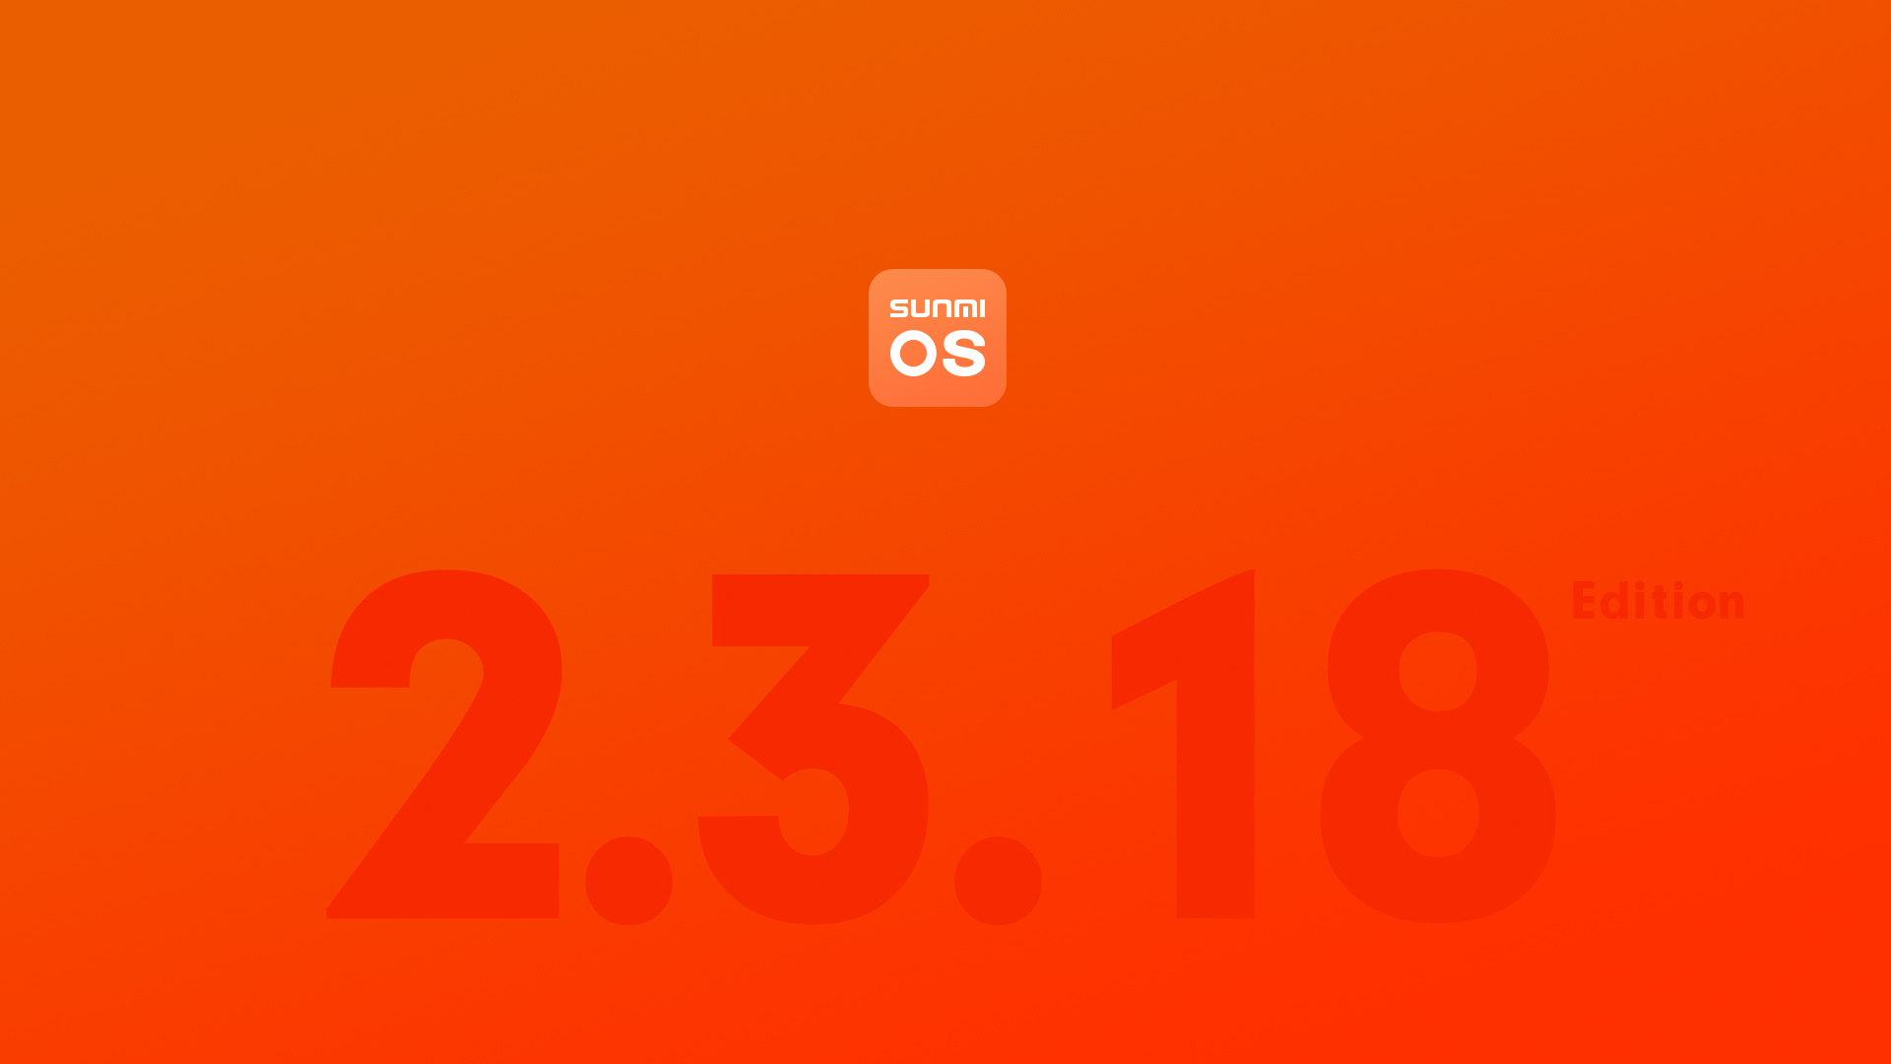
Sunmi OS 2.3.18
Sunmi OS, an customized operating system based on Android, supports all installation of Android-based applications, designed for smart commercial scenes. It deals well with user experience, performance improvement and commercial design, which make commercial devices smarter and more powerful.

Slide 4
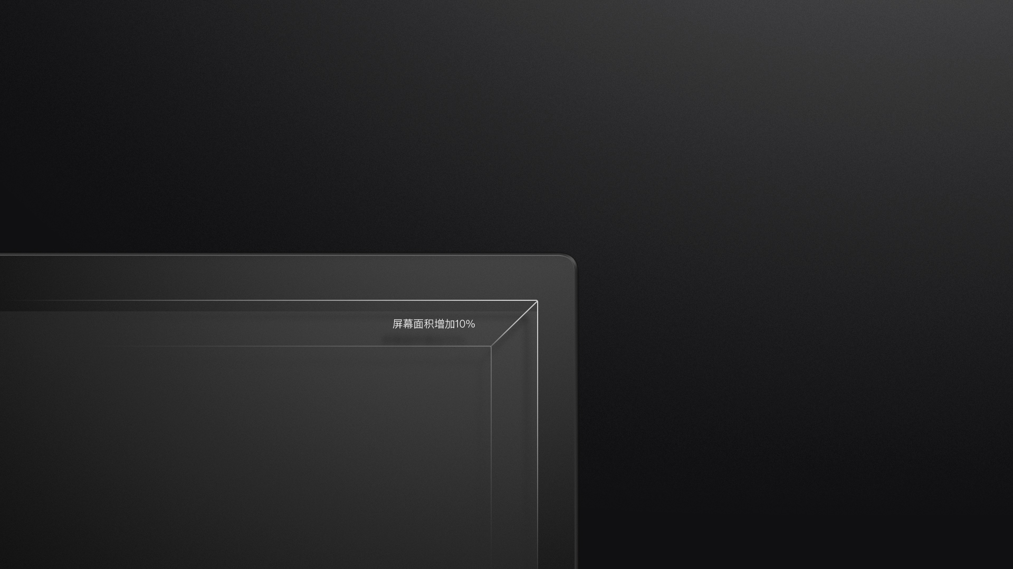
Bigger and Clearer
Screen size upgrade, variety of configuration options.
Main screen upgrade to 15.6" so as to show more details and bring a different shocking experience.
Customer screen upgrade to 10.1" so as to show more details and bring a different shocking experience.

Slide 5
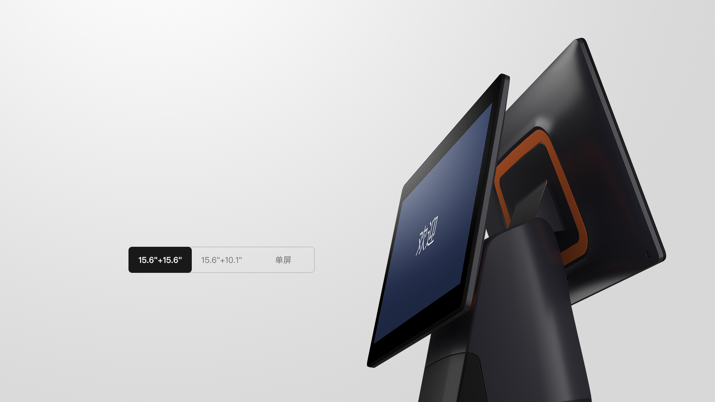
Screen size upgrade,
variety of configuration
options.

Slide 6
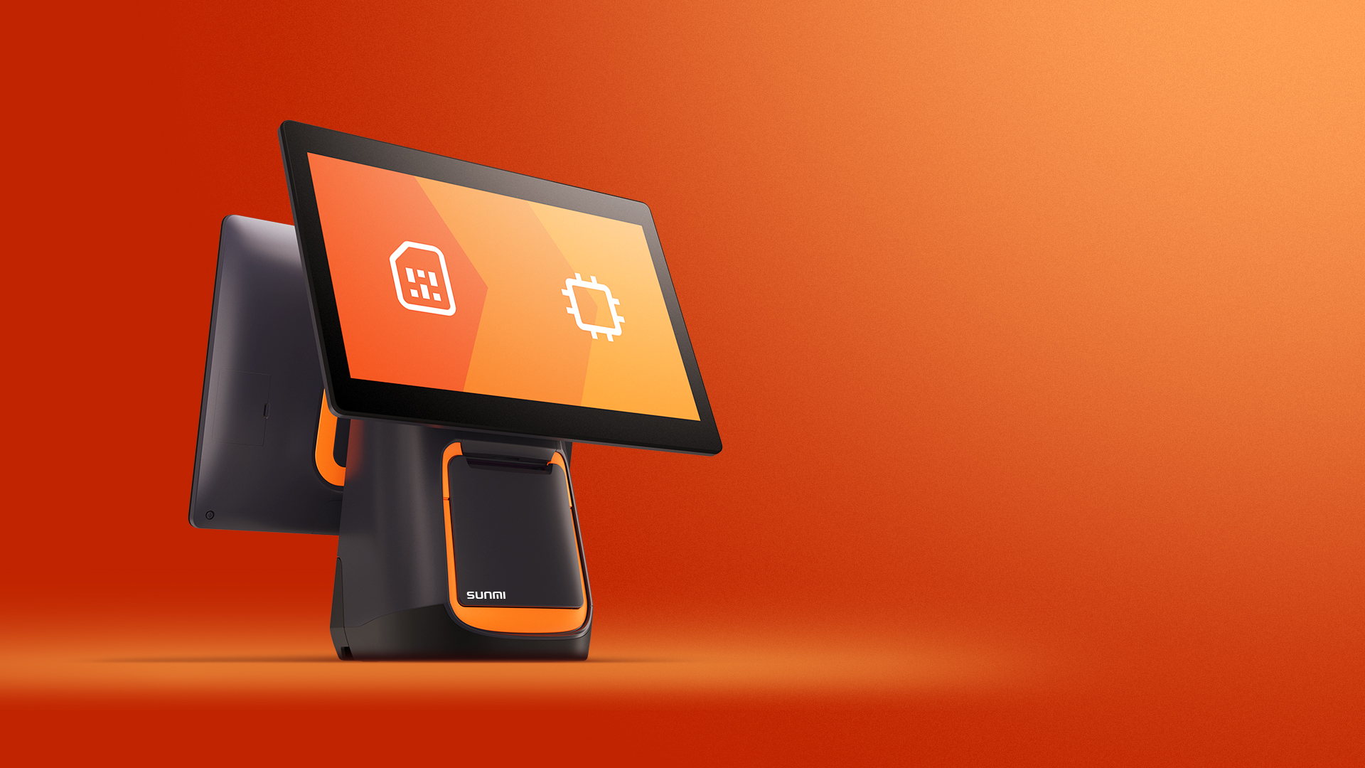
With eSIM Technology
safer and more convenient
T2 series is the first desktop POS terminal that uses the eSIM technology in the industry. With no installation of any SIM cards, it selects operators and opens related services freely. It perfectly avoids the risk of losing the sim card. And even if the terminal lost, users can delete the data remotely to ensure the data security.
*New feature only show on this page, if you need more details please contact to local sales.

Slide 7
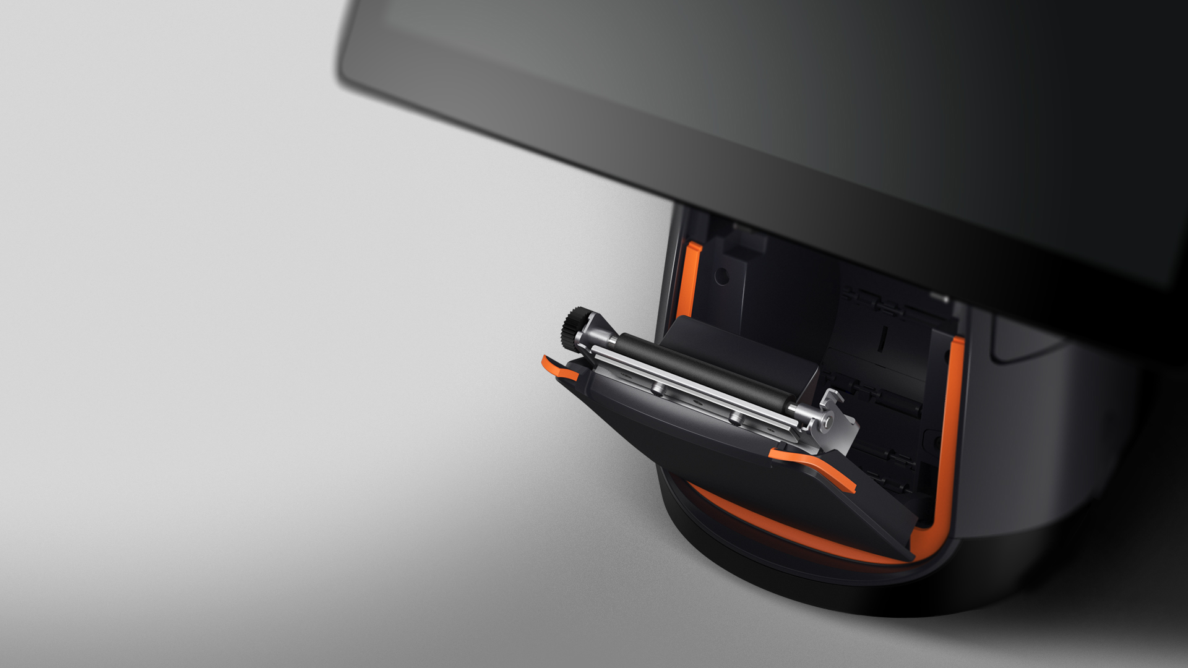
"Zero paper jam" technology
feel efficiency and fluency
Sunmi cooperated with the expert of Seiko have created a new 80mm thermal print with "Zero paper jam" technology. With this technology, T2 is suit for more complicated commercial environment with printing.

Slide 8
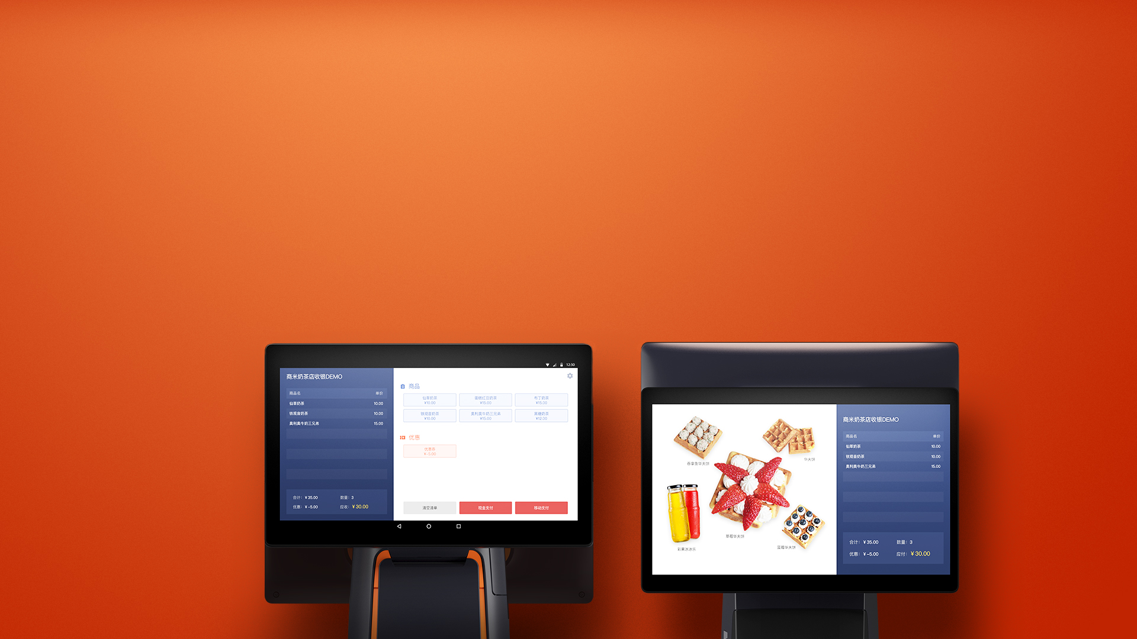
Dual-screen interaction for more efficiency
The smarter dual-screen interactive is more convenient and smoother， you can open an App on the main screen and the it displays same contents on the customer screen.

Slide 9
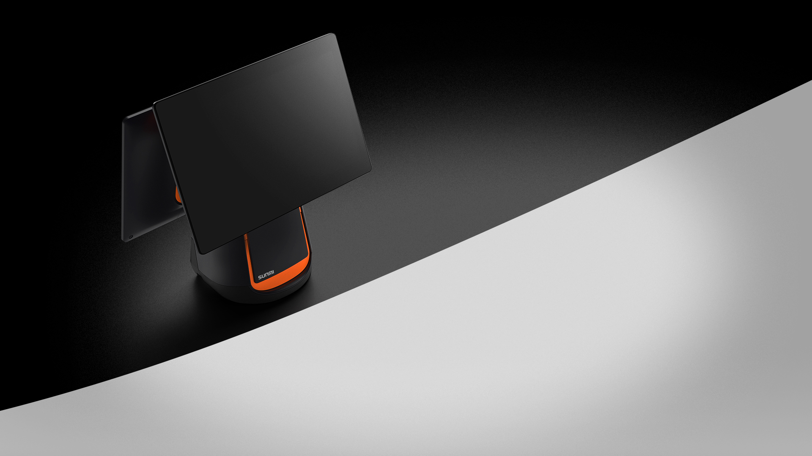
David, the top craftsman
designs T2 series
T2, two international design awards.

Slide 10
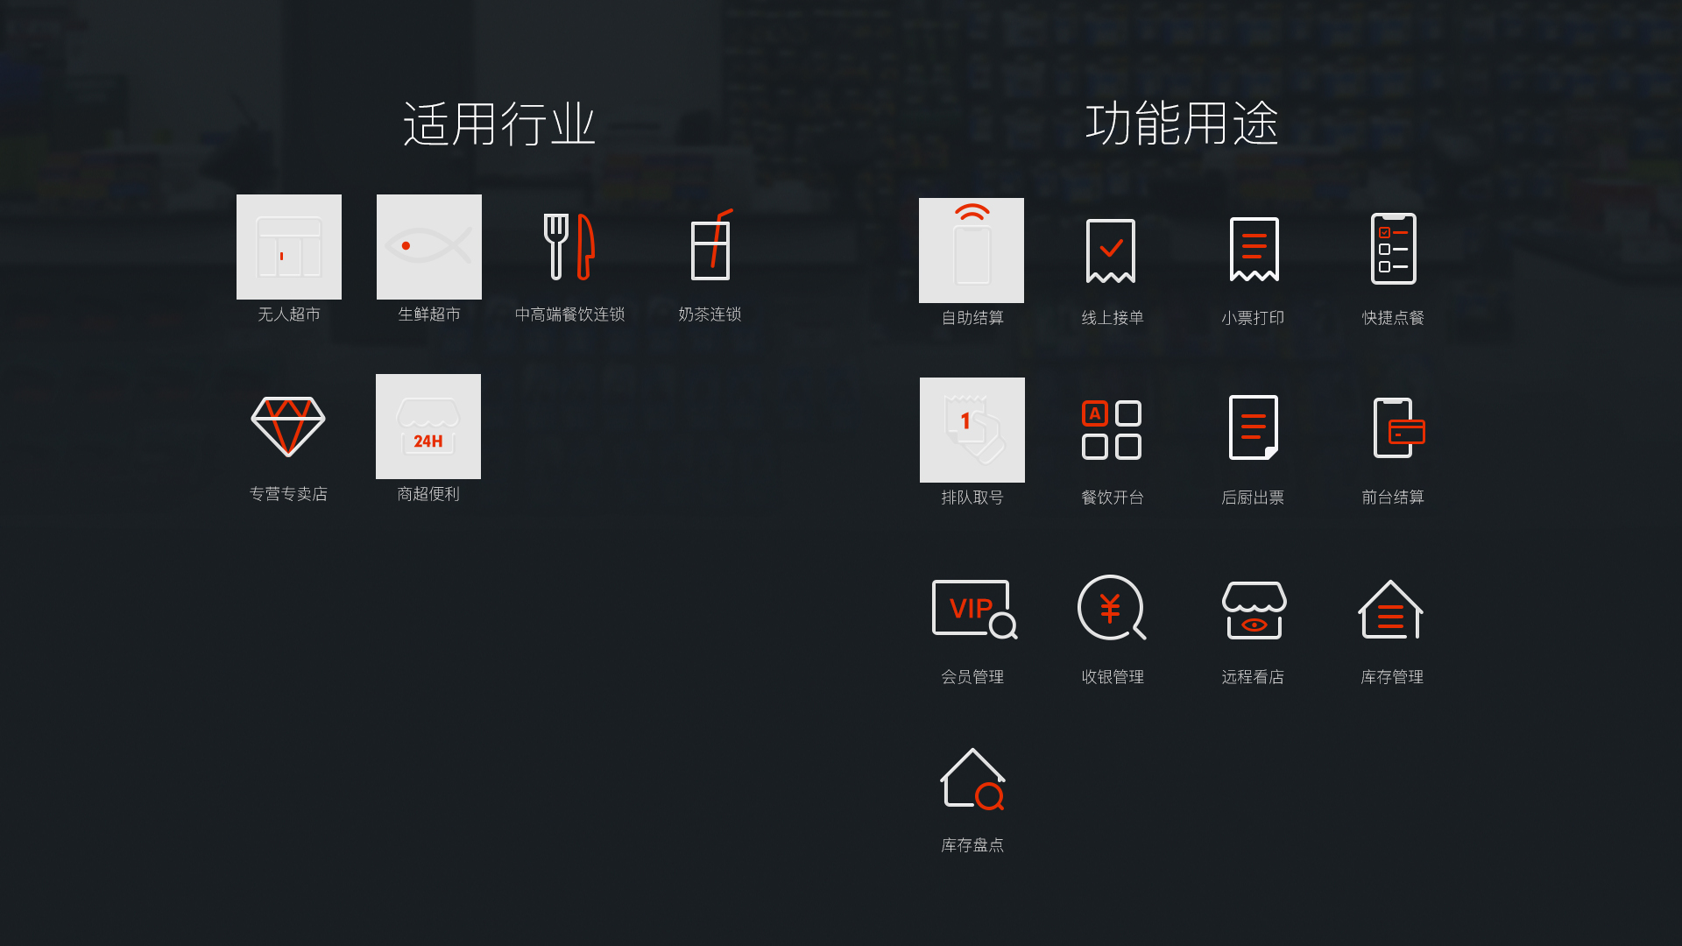

Slide 11
